Slide 1


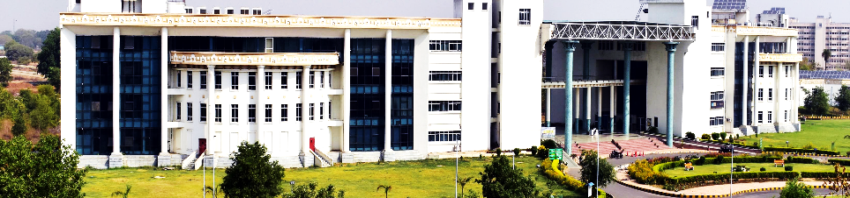
Rishi Raj
Registration Flow Chart for the
27th National and 5th International ISHMT-ASTFE Heat and Mass Transfer Conference (IHMTC-2023)
https://ihmtc2023.iitp.ac.in/

Slide 2
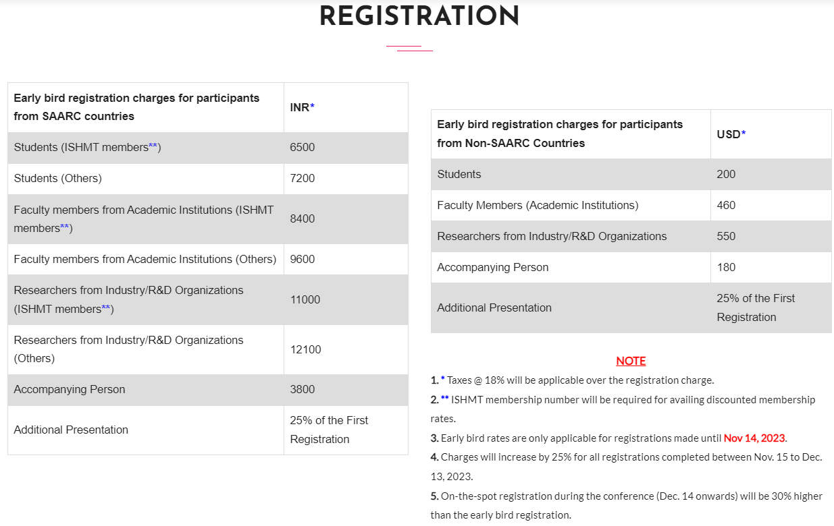
Information at the registration link: https://ihmtc2023.iitp.ac.in/

Slide 3
Email
Password:
Repeat password:
Forgot Password: <Enter email registered>. Forget link

Slide 4
Please enter your name (First name followed by Last name) as you would like it to appear on the conference badge.* (Text) [Title Case]
Please select the appropriate honorific (prefix) that suits your profile.* [Swap with above] (drop down menu)
Prof.
Dr.
Mr.
Ms.
2b GenderM/F+YoBirth1940-2010
Please enter your primary affiliation as you would like it to appear on the conference badge.* (text) [Title Case]
Please choose the country of your primary affiliation.* (drop down menu) - decide if (a) SAARC, or (b) Non-SAARC
Please enter your email address.* (email address) [Validation @ ] , always lowercase
Please enter your contact number.* (drop down for country code + txt box for number) no spaces / allowed
Please enter your WhatsApp contact number. (drop down for country code + txt box for number) no spaces / allowed
How many papers are you presenting (for which you want to register) in this conference?* (drop down menu)
1 (choose this even if you are an attendee not presenting any paper)
2
Registration form

Slide 5
Registration form
Please enter the IHMTC paper # (last three digits of the manuscript ID, in case the manuscript ID has two digits, add a "0" before the manuscript ID) against which this registration should be counted. In case you are just an attendee (not presenting any paper, your answer to Question 8 is 0), please enter 000 as the paper number. (3 Field Text Entry) [000-999]
ID of paper # 1*
ID of paper # 2 (not compulsory)
Choose from amongst the following.* (drop down menu)
I am a student
I am a faculty
I am affiliated with industry/research labs/others
How many other (don’t include yourself) persons (not attending technical sessions) are accompanying you?* (drop down menu)
0
1
2
Are you an ISHMT member? * (drop down menu)
Yes
No

Slide 6
Registration form
Please enter the IHMTC paper # (last three digits of the manuscript ID, in case the manuscript ID has two digits, add a "0" before the manuscript ID) against which this registration should be counted. In case you are just an attendee (not presenting any paper, your answer to Question 8 is 0), please enter 000 as the paper number. (3 Field Text Entry)
ID of paper # 1*
ID of paper # 2 (not compulsory)
Choose from amongst the following.* (drop down menu)
I am a student
I am a faculty
I am affiliated with industry/research labs/others
How many other (don’t include yourself) persons (not attending technical sessions) are accompanying you?* (drop down menu)
0
1
2
Are you an ISHMT member? * (drop down menu)
Yes
No

Slide 7
Registration form
[Dynamic] If you answer to question # 12 is yes, upload the copy of your current/updated (valid only) ISHMT ID (pdf or image). (upload field) [If only above answer is Yes]. Take the number in textbox and also ask to upload.
Submit / Compute Registration Fees
New page opens with the following message:
Your registration category is _________ (see next slide)
Your registration amount is _______Rs/$ (see next slide)
Please visit the following payment link (_____), provide the relevant information, make the payment for the above- mentioned amount and the category, and come back here to complete the remaining questions below.
Upload the copy (pdf/image) of payment receipt.* (upload field)
payment_reference_number*
Any other comment? (text box)
Submit
A predefined message stating the details and amount of registration will appear. The same will also be sent to the email ID provided.

Slide 8
Admin
Admin Login
admin_ihmtc@iitp.ac.in
Pass: ihmtc2023@
Enter Email:
<>
Find record -→ Name, Phone, Country etc.
<Delete button; are you sure>
User Page:

Slide 9
CATEGORIES OF REGISTRATION
SSM
SSN
NSN
NFN
SFM
NIN
SFN
SIM
SIN

Slide 10
If Chosen options are 4a, 10a, 12a,
Category is SSM
Basic registration fee is Rs [6500( 1 + 0.25*(Ans₈ -1)) + Ans₁₁*3800 ]
If Chosen options are 4a, 10a, 12b,
Category is SSN
Basic registration fee is Rs [7200( 1 + 0.25*(Ans₈ -1) )+ Ans₁₁*3800 ]
If Chosen options are 4a, 10b, 12a,
Category is SFM
Basic registration fee is Rs [8400( 1 + 0.25*(Ans₈ -1) )+ Ans₁₁*3800 ]
If Chosen options are 4a, 10b, 12b,
Category is SFN
Basic registration fee is Rs [9600( 1 + 0.25*(Ans₈ -1) )+ Ans₁₁*3800 ]
If Chosen options are 4a, 10c, 12a,
Category is SIM
Basic registration fee is Rs [11000( 1 + 0.25*(Ans₈ -1)) + Ans₁₁*3800 ]
If Chosen options are 4a, 10c, 12b,
Category is SIN
Basic registration fee is Rs [12100( 1 + 0.25*(Ans₈ -1) )+ Ans₁₁*3800 ]
Equation
If Chosen options are 4b, 10a, 12a/b,
Category is NSN
Basic registration fee is USD [200( 1 + 0.25*(Ans₈ -1)) + Ans₁₁*180 ]
If Chosen options are 4b, 10b, 12a/b,
Category is NFN
Basic registration fee is USD [460( 1 + 0.25*(Ans₈ -1)) + Ans₁₁*180 ]
If Chosen options are 4b, 10c, 12a/b,
Category is NIN
Basic registration fee is USD [550( 1 + 0.25*(Ans₈ -1))+ Ans₁₁*180 ]
Total registration amount up to 11:59 PM on 14/11/2023 IST
Basic registration x 1.18
Total registration amount from 15/11/2023 onwards
Basic registration x 1.25 x 1.18

